Slide 1
PYTHON PROGRAMMING
MODULE 3

Slide 2
Pre-requisted knowledge
Logic
Number range

Slide 3
Quick Test
Select the value/s of y if y is less or equal to 4?
a) 4 b) 5 c) 3
Which is the value of x if x is more than 5?
a) 6 b)5 c)4

Slide 4
Flowchart
Now, let us learn about flow chart first, before we continue our programming sessions.

Slide 5
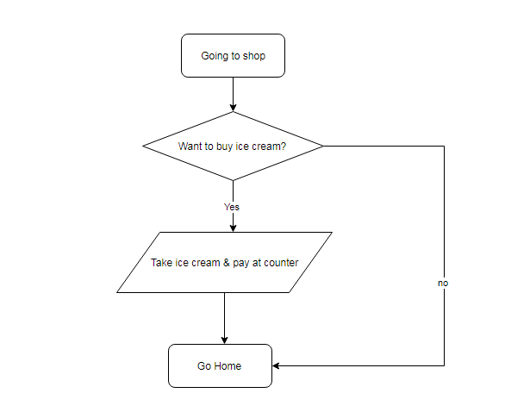
Decision Making

Slide 6
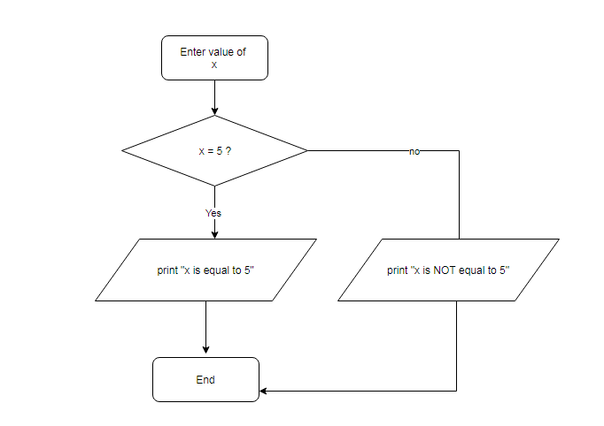
Logical Flowchart

Slide 7
Decision Making in Python
In order to make a decision, computer only understand two condition, ‘yes’ or ‘no’.
Therefore, if we want to create a program that ask computer to make a decision, we must follow the “if-else” condition

Slide 8
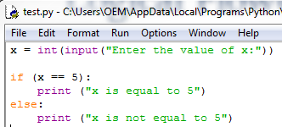
Example

Slide 9


Output of example
If user enter 5
If user enter other than 5

Slide 10
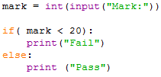
Application #1
By using ‘if-else’ statement, we can determined the status of our exam marks. Whether we ‘pass’ or ‘fail’.
E.g: The student will ‘fail’ if they get marks below 20.

Slide 11
MULTIPLE CHOICES

Slide 12
What if we need to choose more than 2 option?
In this section, we will learn how the computer decide more than 2 options.
Computer will compare ‘if’ and ‘else’ statements. But in multiple choices, there is another statement called ‘else-if’.
In python, ‘else-if’ is defined as ‘elif’

Slide 13
Example
We want to know the grades of our marks in exam.
Grade | Marks
A | 80-100
B | 60-79
C | 40-59
D | 20-39
E | 0-19

Slide 14
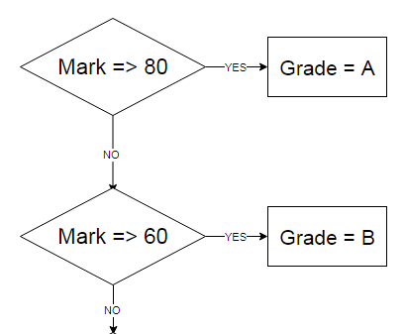
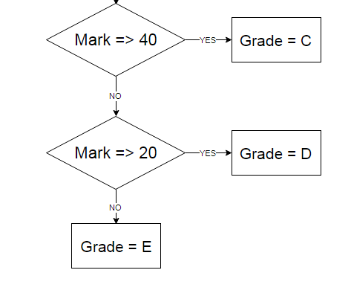
Flowchart

Slide 15
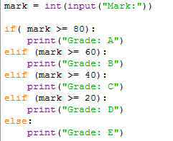
The codes

Slide 16
FOR LOOP
Print repeated lines with fixed counter

Slide 17


Write same lines
If we want to write the same line, usually we will write like this format:
Output:

Slide 18

However… we can simplify them!
We can simplify them using this format:
Can you see the differences? We will write less lines!

Slide 19
Exercise
Try to write multiple lines of
“I love My Parents!”

Slide 20
WHILE LOOP

Slide 21
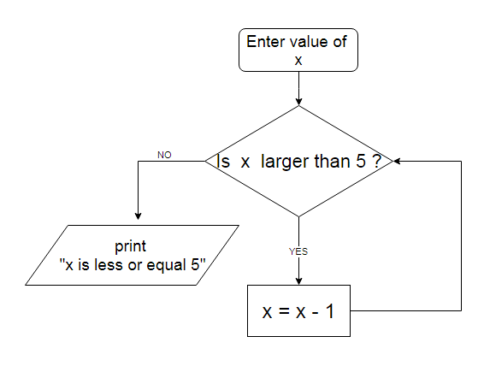
Repetition / Loops

Slide 22
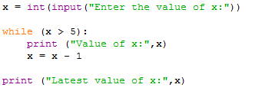
Repetitions/ Loops in Python

Slide 23
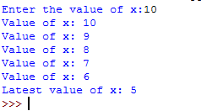
Output

Slide 24

Application #2
By using LOOPS, we can ask computer to make a multiplication table.
Just write like this:

Slide 25
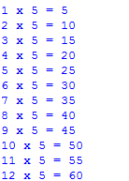
Output

